Slide 1

MMCoQA: Conversational Question Answering over Text, Tables, and
Images
Yongqi Li, Wenjie Li, Liqiang Nie
Proceedings of the 60th Annual Meeting of the Association for Computational Linguistics Volume 1: Long Papers, pages 4220 - 4231
Presented By Group 50
Baladitya Swaika, Bowen Shi, Henil Shelat, Prashant Vibhor Agarwal, Sunit Ashish Vaidya

Slide 2
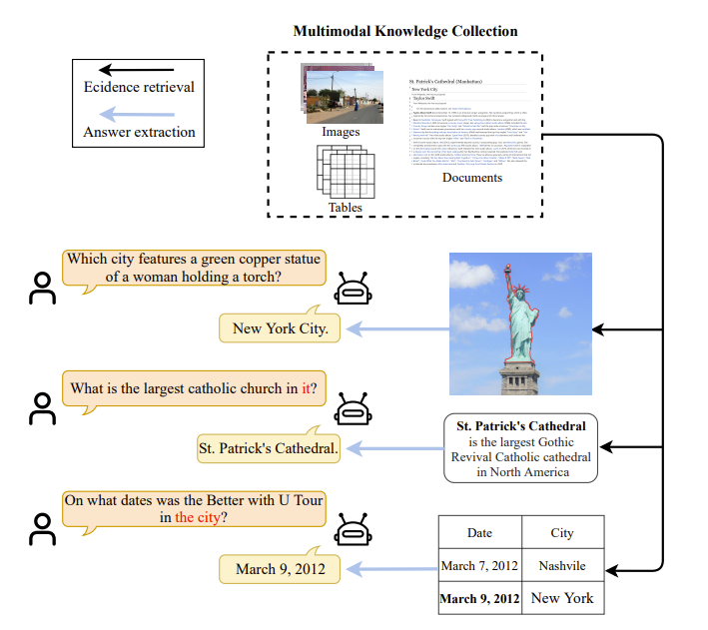
Illustration of multimodal conversational question answering

Slide 3
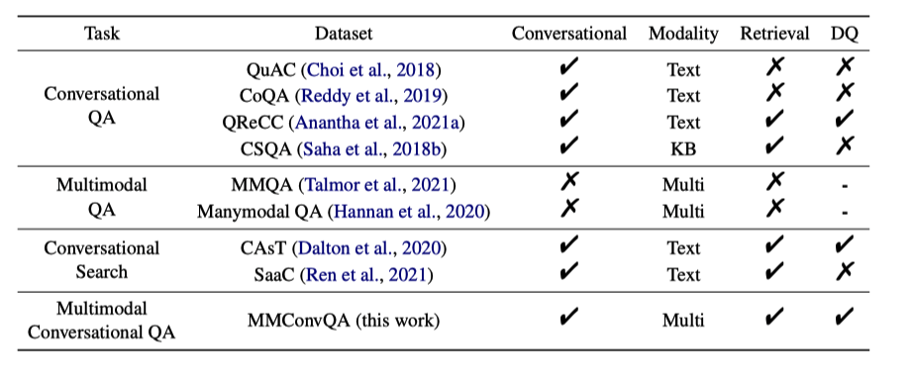
Overview and Related Work
Threefold:
Define scope and challenges
Construct dataset
End-to-end model as baseline
MMConvQA Challenges:
Priority of multimodal knowledge
Consistency of multimodal knowledge
Complementarity of multimodal knowledge

Slide 4
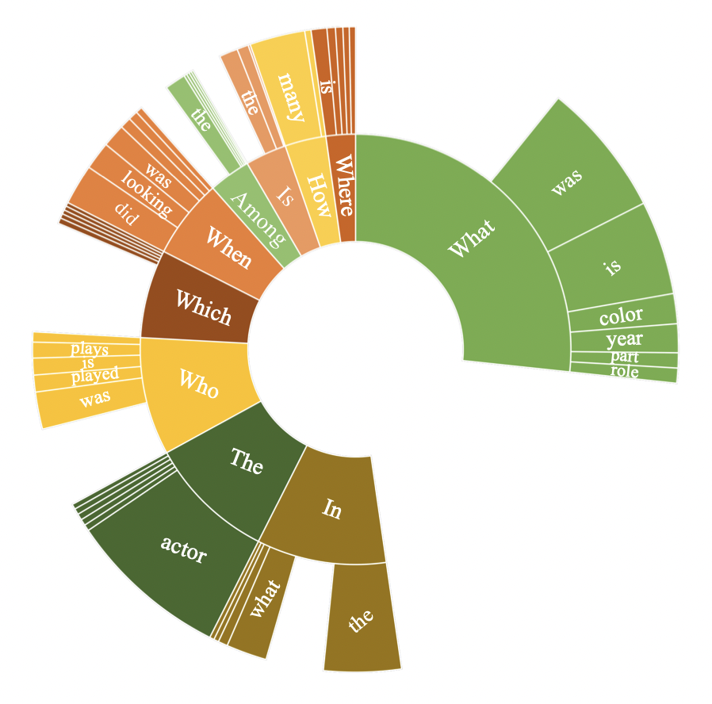
Dataset Construction
MMQA Dataset:
Pipeline:
Generating potential conversations to existing questions.
Generate Potential Conversations:
Identify the entities of the question text and answer. Add questions
based on a randomly selected entity which are refined by annotators.
Decompose Complex Questions:
Annotators decompose complex questions into self-contained questions
without the need of conversational context.
Refining Conversational Questions:
Refining conversational questions after understanding the linguistic
phenomenons like coreference and ellipsis.
Data Quality:
Quality of conversational data is ascertained using the 5-step scheme of training, annotation, checking, modification, and re-checking.

Slide 5
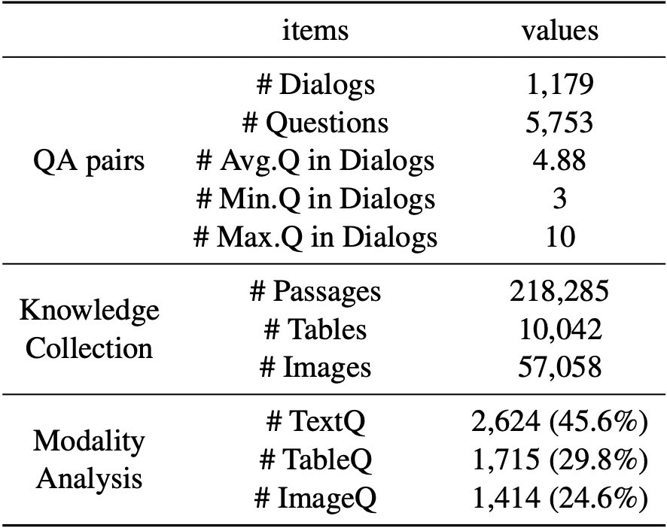
Dataset Analysis
Each question is annotated with related evidence (table,
image or text/passage and a natural language answer.
Question Analysis:
Many questions with same first words but different meanings,
often used to identify patterns featuring multi-modalities.
Duplicate questions exist in the dataset.
Answer Analysis:
Most answers are text passages, cells of tables, title of images,
sometimes different answers that do not relate to the evidence.
Modality Analysis:
As the conversation progresses questions dynamically require
different modalities of knowledge to answer.
Linguistic Phenomenon:
Quality of conversational questions analyzed by understanding the reliance of answering based on coreference markers with conversational history.

Slide 6
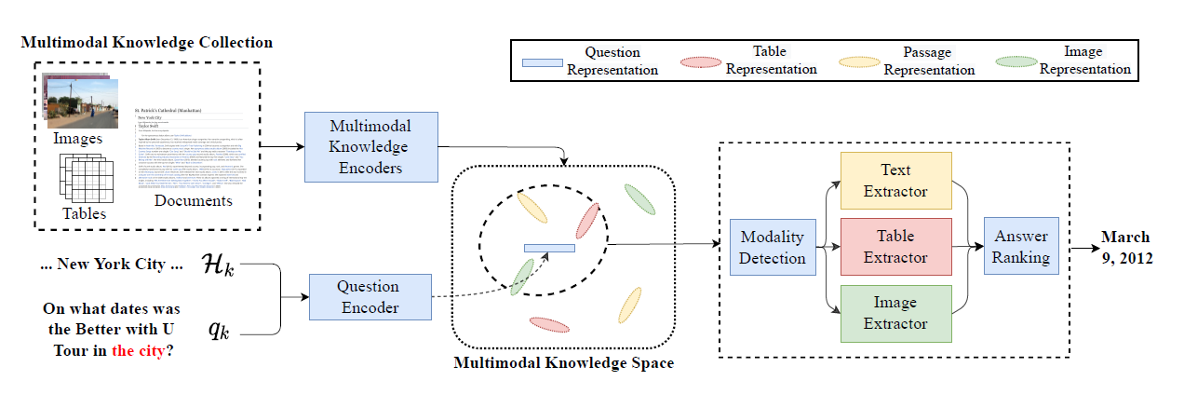
Multimodal Conversational QA system with Adaptive Extractors (MAE)

Slide 7
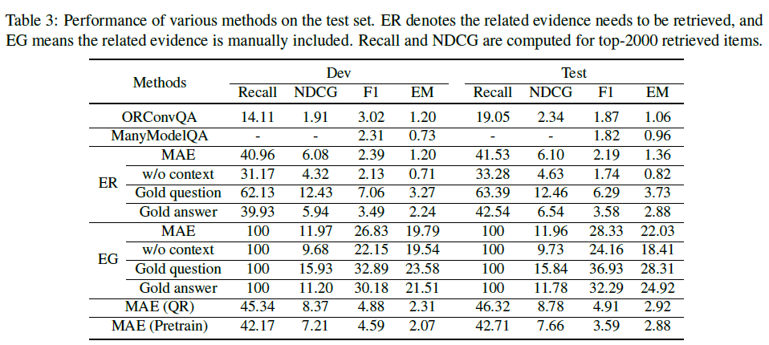
Snapshot of Performance

Slide 8
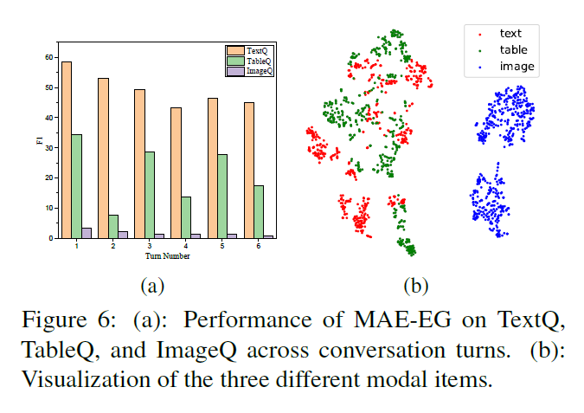
Results and Analysis
Metrics
Recall
Normalized Discounted Cumulative Gain
Macro-averaged F1
Exact Match
Baseline Models
ORConvQA
ManyModalQA
Results
MAE model is much better suited than others
Using extra data helps since small dataset
Evidence retrieval is a bottleneck
Modality Analysis

Slide 9
Challenges and Critical evaluation
The quality of the MMConvQA dataset is partly evaluated.
Dataset size is very small.
Adding evidence to the dataset makes the current model very complex.
Image embeddings are isolated from each other and there is no common space where the embeddings are evenly distributed.
The isolated embeddings of the images demonstrate a lack of alignment between the visual and semantic meanings.
One of the major challenges is to make the embeddings dense, to align the visual and semantic meanings.
Vector space alignment technique can be used in order to resolve the alignment problem
.

Slide 10
Thank You!

Slide 11
Multimodal Conversational QA system with Adaptive Extractors
#1 Problem Formulation
Current Question q_{k}
MAE
Context H_{k}
Natural Language Span a_{k}
Knowledge Collection {C_{p}UC_{t}UC_{i}}

Slide 12




Multimodal Conversational QA system with Adaptive Extractors
#2 Question and Multimodal Knowledge Encoder
Passage
Reformatted Question by filtering on Context
Linearized Tables
Image
BERT-based Encoders
Pre-trained ResNet
*All embedding vectors have the same dimensions

Slide 13
Multimodal Conversational QA system with Adaptive Extractors
#3 Evidence Retrieval
Compute inner product of question embedding with knowledge collection embeddings to calculate similarity s_{a} and select top N items as evidence
Multimodal Knowledge Space

Slide 14
Multimodal Conversational QA system with Adaptive Extractors
#4 Adaptive Answer Extractor
Treat modality detection as a multi-class classification task and compute a modality score s_{b}
Extractors work by computing probabilities of start and end tokens in text for tables and passages and in answer set for images
Answers are ranked on total overall score; similarity, modality score and token probabilities
Text Extractor
Modality Detection
Table Extractor
Answer Ranking
Image Extractor

